Slide 1

Vel Tech Rangarajan Dr. Sagunthala R&D Institute of Science and Technology
School of Computing
Department of Computer Science and Engineering
10211CS224 / FULL STACK APPLICATION DEVELOPMENT (JAVA)
MILESTONE PROJECT FINAL REVIEW
Date: 06-05-2026
SMART CAMPUS EVENT MANAGEMENT SYSTEM
SDG: SDG No – SDG 4 – Quality Education
Presented By:
C.ABHINAY REDDY – VTU26894 – Reg.No.23UECS0117
Courses Handling Faculty:
Dr. Hafizur Rahman- B.E., M.Tech., Ph.D.

Slide 2
INTRODUCTION
1
• Managing campus events manually can lead to confusion, missed registrations, and poor coordination.
• In colleges, organizing workshops, seminars, and events efficiently is very important.
• This project aims to provide a simple and efficient Smart Campus Event Management System.
• It allows students to view upcoming events, register, and provide feedback easily.
• Admins can create, update, and delete events through a centralized system.
• The application is built using Spring Boot, Thymeleaf, and MySQL.
• This project demonstrates real-world web application development and CRUD operations.
2
3
4
5
6
7
8
9

Slide 3
PROBLEM STATEMENT
• Manual management of campus events often leads to errors and miscommunication.
• Students may miss important event updates due to lack of a centralized system.
• Registration processes are not organized and can lead to data loss.
• Event details are not easily accessible to all students.
• Managing multiple events manually becomes time-consuming for administrators.
• Lack of proper feedback collection affects event improvement.
• No efficient system to update or delete event information dynamically.
• Overall, the absence of a digital system reduces efficiency and coordination.
1
2
3
4
5
6
7
8
9

Slide 4
OBJECTIVE(S)
• To develop a Smart Campus Event Management System for efficient event handling.
• To allow students to view all upcoming events in a centralized platform.
• To enable students to register for events easily through an online system.
• To provide a feedback mechanism for improving event quality.
• To allow admins to create, update, and delete event details.
• To maintain all event and registration data in a structured database.
• To improve communication between students and event organizers.
• To reduce manual work and increase system efficiency.
1
2
3
4
5
6
7
8
9

Slide 5
PROPOSED SYSTEM
• The proposed system is a Web-Based Smart Campus Event Management System developed using Spring Boot, Thymeleaf, and MySQL.
• It allows students to view all upcoming events and access event details in a centralized platform.
• Students can easily register for events and provide feedback through online forms.
• Admins can create, update, and delete event information dynamically using the system.
• All event, registration, and feedback data are securely stored in a MySQL database.
• The system provides a user-friendly interface for both students and administrators.
• Compared to manual systems, it is more reliable, organized, and scalable.
1
2
3
4
5
6
7
8
9

Slide 6
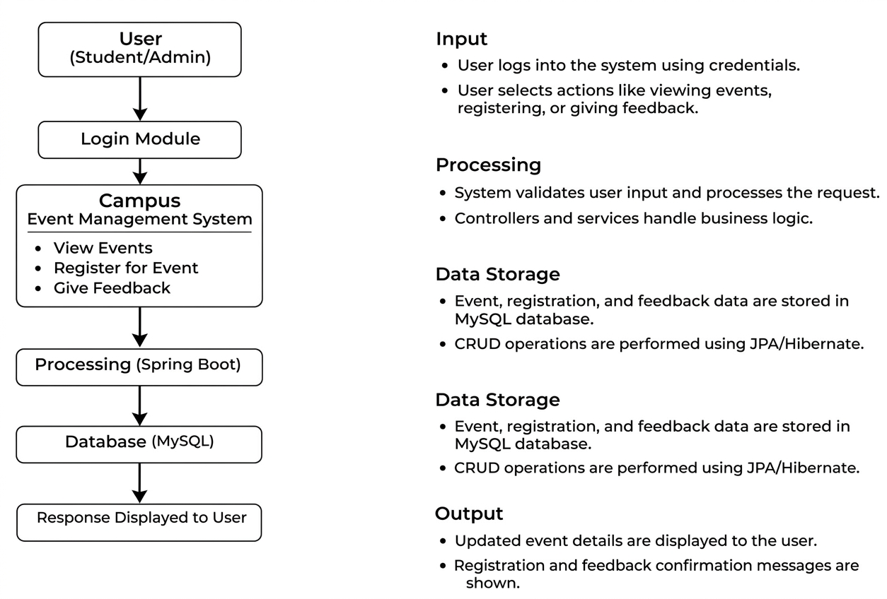
PROPOSED SYSTEM ARCHITECTURE
1
2
3
4
5
6
7
8
9

Slide 7
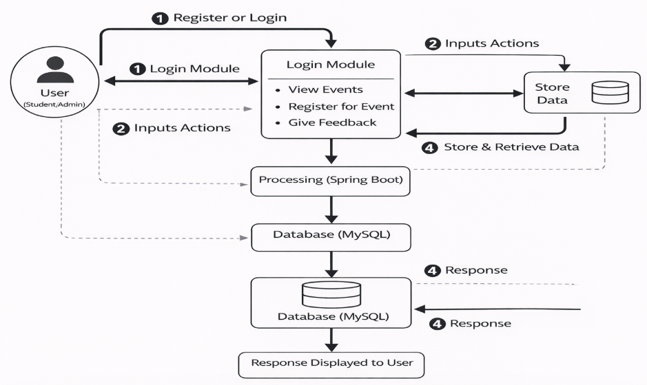
WORKFLOW
1
2
3
4
5
6
7
8
9

Slide 8
TECHNOLOGIES USED
Frontend:
HTML5
CSS3
Thymeleaf
Backend:
Spring Boot
Spring MVC
Database:
MySQL Workbench
Server:
Tomcat Server
Tools:
VS Code
MySQL Workbench
Web Browser (Chrome)
Postman (API Testing)
Hardware / Software Requirements:
System: Windows 10
RAM: Minimum 4GB
Software:
Java JDK (17 or above)
Apache Tomcat Server
MySQL Server
1
2
3
4
5
6
7
8
9

Slide 9
MODULE DESCRIPTION
Module 1: User Authentication Handles login for admin using basic authentication. Restricts unauthorized access to admin features.
Module 2: Event Management
Add new events with name, department, type, and date. Update and delete events using CRUD operations.
Module 3: Student Interaction
Allows students to browse upcoming events. View event details using MVC pages and REST APIs.
Module 4: Event Registration
Students can register for events with form validation. Module 5: Search & Filters
Search events based on date, department, and type. Displays filtered results dynamically.
1
2
3
4
5
6
7
8
9

Slide 10
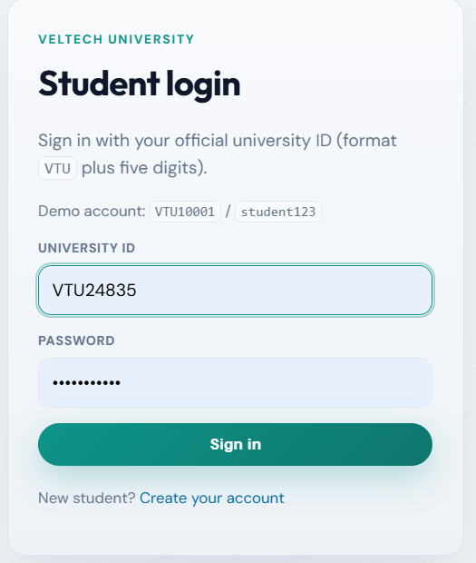
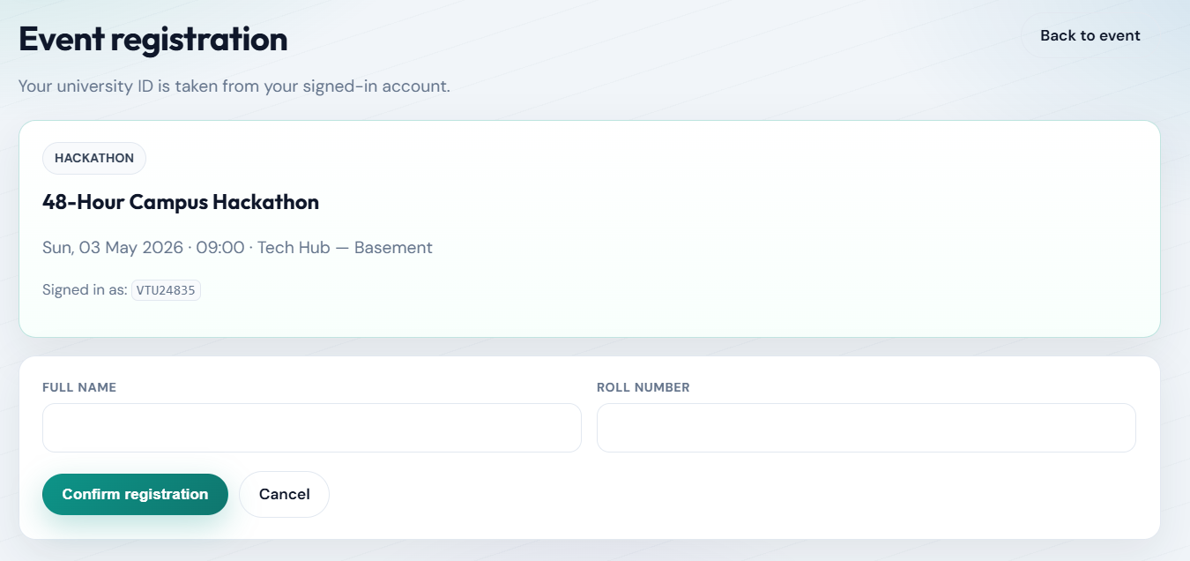
IMPLEMENTATION SCREENSHOTS
1
• The User Login module authenticates registered users using their university ID and password. • The system verifies the credentials from the database and grants access to the dashboard upon successful login. • If the credentials are incorrect, an error message is displayed to ensure secure access control.
2
3
4
5
6
7
8
9

Slide 11
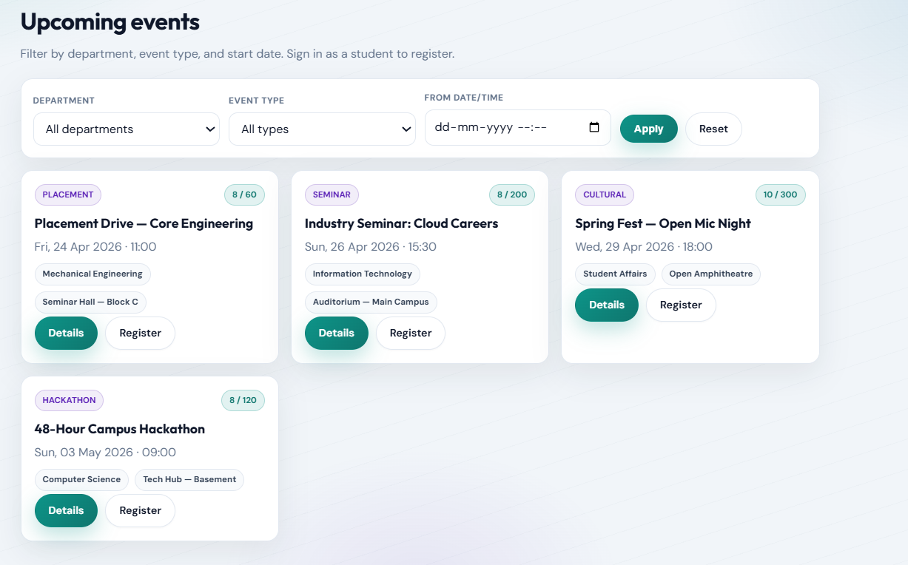
IMPLEMENTATION SCREENSHOTS
Shows a list of upcoming events with complete details such as ID, title, description, department, type, and date.
Provides a search bar to filter events based on department (e.g., CSE, IT) for quick access.
Allows admin actions like Edit and Delete, and student actions like Register for Event and Give Feedback after the event.
1
2
3
4
5
6
7
8(A)
9

Slide 12
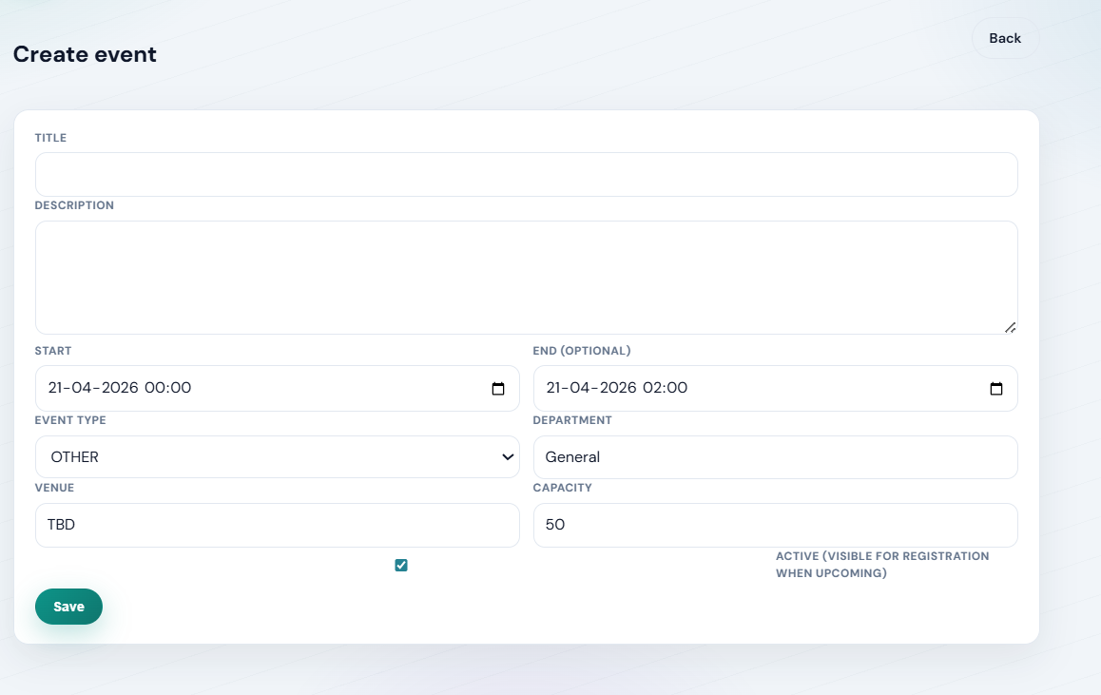
IMPLEMENTATION SCREENSHOTS
1
Allows admin to modify existing event details such as title, description, department, type, and date.
Pre-filled form fields display current event information for easy editing and updates.
Provides a single action button to submit and save the updated event details.
2
3
4
5
6
7
8(B)
9

Slide 13
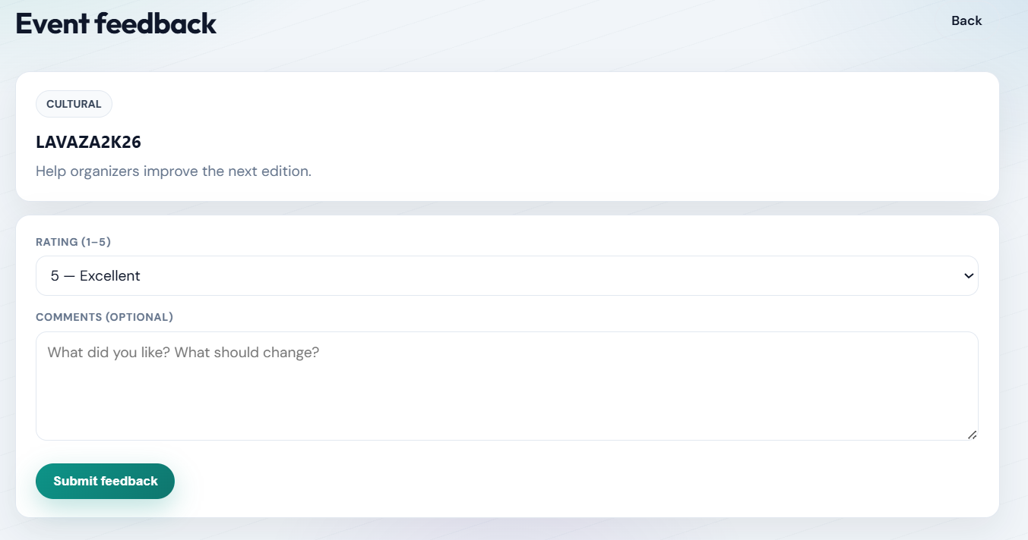
IMPLEMENTATION SCREENSHOTS
1
Allows students to submit feedback for a specific event by entering their name and event ID.
Provides a text area for users to write detailed feedback about their experience.
Includes a submission button to send and store feedback in the system.
2
3
4
5
6
7
8(C)
9

Slide 14
ADVANTAGES & LIMITATIONS
Advantages:
• Simple and user-friendly interface. • Complete CRUD functionality for event management. • Secure admin access using basic authentication. • Centralized database for storing events and registrations. • Easy event search using filters (date, department, type).
Limitations:
• Basic UI design without advanced styling or responsive layout. • No email or notification system for event updates. • Limited authentication (only basic admin login, no role-based access). • Depends on local server and database configuration. • No mobile application support.
1
2
3
4
5
6
7
8
9

Slide 15
Thank you

